Slide 1
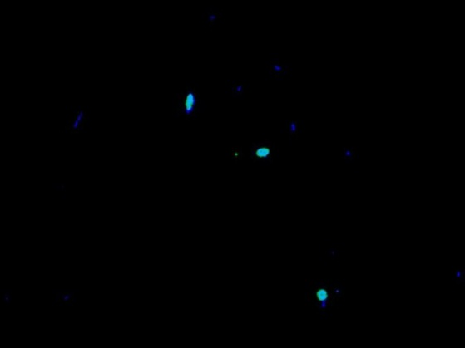
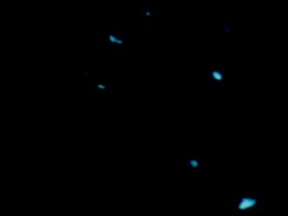
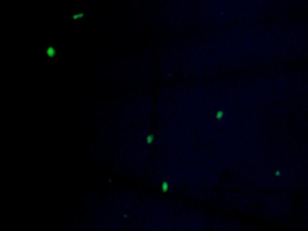
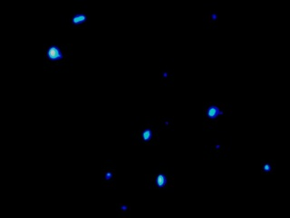
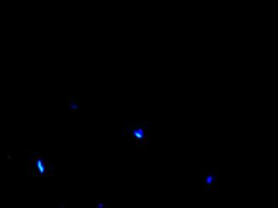
Figure S3.
A
B
C
D
Figure S3. FISH assay with various probes. The Biomasher-pellet from healthy leaves were filtered with 5 µm and used for FISH assay. Left panels, FISH with respective probes; right panels, DAPI staining. Scale bars indicate 10 µm. A, LSS (Las-specific) probe; B, ALF968 (α-proteobacteria-specific) probe; C, EUB338 (eubacteria-specific) probe; D, NON (invalid) probe.

